Slide 1

UI French Fry
Atlanta Community Food Bank (ACFB)
Emma Hanson, Erin Kim, Hye Lim (Hannah) Kim, Philena Yang, Zehao (Tim) Tan
Notes:
SLIDES 1 & 2 - 30sec-1 minute
Introduction: Group name, members, what problem you are trying to solve; 30sec-1 minute, Title slide and problem statement slide.
And we designed a food delivery system for the Atlanta Community Food Bank

Slide 2

Problem Statement
Accessing food and resources provided by Atlanta Community Food Bank is a big issue for food insecure people
Our System: support accessibility needs by establishing an ACFB delivery service in and outside of metro Atlanta
User Groups
Primary: food insecure people and ACFB organizers
Secondary: ACFB volunteers
Tertiary: ACFB donors
Tasks
Schedule a food delivery via the ACFB website
Sign up to volunteer to delivery food via the ACFB website
View delivery requests to coordinate volunteers via the organizer portal
Notes:
SLIDES 1 & 2 - 30sec-1 minute
Introduction: Group name, members, what problem you are trying to solve; 30sec-1 minute, Title slide and problem statement slide.
In our analysis of the problem space, we considered data from various sources, including ACFB’s website, surveys with proxy users, and studies regarding transportation and food insecurity in the Atlanta area. We found that accessing food and resources provided by ACFB is a big issue for food insecure people in and outside of metro Atlanta. While the current systems of public transportation, limited delivery services, and popup food pantries attempt to provide food insecure people access to resources, they fail to meet their needs as data shows that food insecurity is fastest growing in rural areas of Atlanta, where there is little public transportation and issues of internet access. As the need for distribution of food and resources to food insecure people with issues of mobility rises, the goal of our system is to support accessibility needs by establishing an Atlanta Community Food Bank delivery service in and outside of metro Atlanta, bridging the gap between food insecure people and ACFB provided food and resources.
Our primary user groups include food insecure people and ACFB organizers. The secondary user group is ACFB volunteers, and the tertiary user group is ACFB donors.
Tasks that our system supports include:
Schedule a food delivery via the ACFB website (food insecure people)
Sign up to volunteer to delivery food via the ACFB website (ACFB volunteers)
View delivery requests to coordinate volunteers via the organizer portal (ACFB organizers)

Slide 3

Requirements
Functional
Information collection
View delivery requests’ details
Availability feedback
Non-Functional
Usability
Utility
Accessibility
Reliability
Notes:
Requirements: What requirements did you identify? List the most important first, and tell us why they are the most important; 1 minutes.
Functional Requirements
Information collection: As the system’s main functional component is to set up a method for food insecure people to receive ACFB’s food services, it will need to gather user information, including name, location, contact, food preferences, and availability for food insecure users as well as delivery volunteers
View delivery requests’ details: When delivery requests come in, the system should update the organizer page with new requests. This will enable organizers to effectively coordinate and set up deliveries to food insecure users with delivery volunteers.
Availability feedback: The system must be able to inform users whether delivery is available to them based on their location.
Non-Functional
Usability: The system interface must facilitate the process of requesting food delivery for food insecure people. The interface must be understandable to all users and the information and actions should be presented clearly.
Utility: The interface should allow users to receive useful information and feedback from the information they input.
Accessibility: The system interface must be accessible to as many food insecure people as possible. Technological constraints involving those that don’t have access to the Internet or a smartphone or computer need to be considered in designing the prototype.
Reliability: The system must be reliable for its users. Because it is a food delivery system, an error can result in food insecure people not receiving food and not being able to eat.

Slide 4
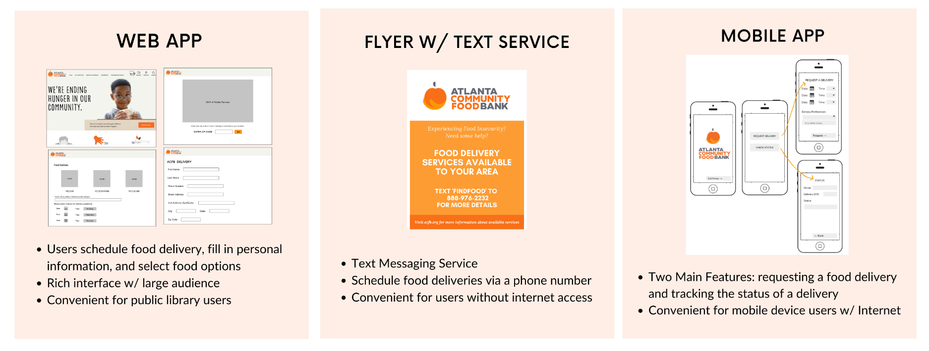
Initial Designs
Notes:
1 Minute
Initial Designs: Summarize the key features of each of your three initial designs. Design concepts and general dialogue styles, not details;
Our 3 Initial designs were a web application, flyer w/ text service, and a mobile application.
The web app is an addition to the existing ACFB website in which users are able to schedule up to 3 food deliveries in one order.
The flyer w/ text service allows users to schedule food deliveries through texting a phone number, and our 3rd design, the mobile app, has 2 main features: requesting a food delivery and tracking the status of a food delivery.
The main difference between the 3 designs are the platforms in which they exist. All three designs would allow users to schedule food delivery, select food preferences, and input dietary needs as needed.

Slide 5
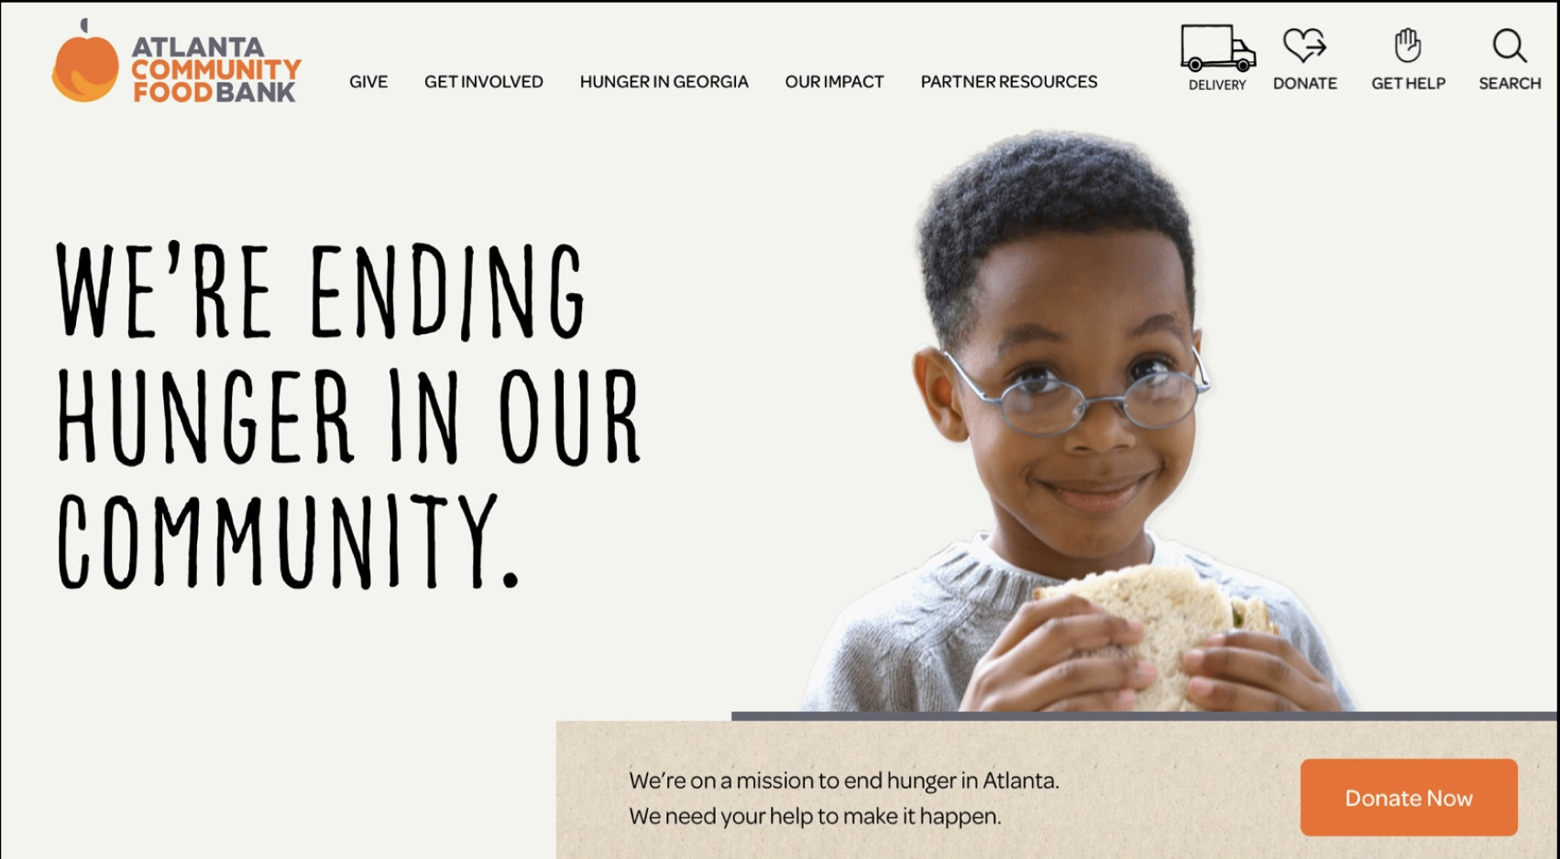
Narrowing Process
Final Prototype: Website
Rationale:
Rated the highest amongst our evaluation criteria (3.9/5)
Accessible to 99.7% of our users (from P1 Survey)
Provides a richer interface for more information and feedback
Easy to maintain and reach a large audience
Notes:
1 Minute
Narrowing process: What final prototype did you choose, and why?
We chose the website as our final prototype because it rated the highest amongst our evaluation criteria as well as in the feedback from the poster session. The website would be able to support all of the functionality needed for users to accomplish their tasks by providing a richer interface for more information and feedback. This enables the system to meet the functional requirements, including collecting information from users, providing feedback, and showing delivery request details. The web interface would be easier to navigate when providing information, as well as when looking at data. In addition, from our survey in P1, we found that most users had access to a laptop device and the Internet, so 99.7% of users would be able to use our website. The system is also accessible in the case that the users don’t have access by providing the opportunity for users to go to public spaces like libraries to use laptops to access the website. All in all, the website easily meets all of our functional requirements, scored the highest when evaluated against our evaluation criteria, and was the most accessible for users.

Slide 6
Final Prototype Demo
-go to video of demo
Notes:
2 Minutes
Final Prototype Demo Video: A very fast walk-through of the prototype you built for evaluation (including any changes you made during the evaluation process);

Slide 7
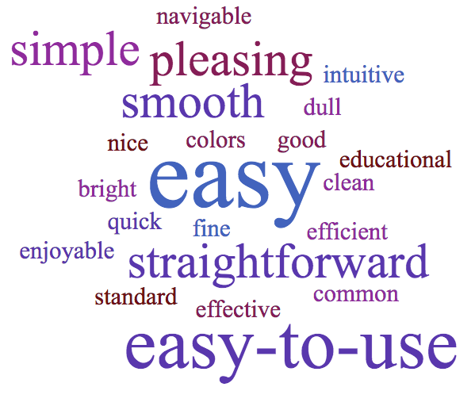
Evaluation Results
Evaluated based on completion, number of extra clicks, and several open-ended questions
Task 1: Sign up to receive a food delivery
Task 2: Sign up to deliver food as a volunteer
Task 3: Sign in to site to view sign ups
Not much confusion with Task 1
Some confusion with differences in volunteering tabs for Task 2
Confusion with locating sign in button for Task 3
Notes:
We evaluated our prototype by asking 10 proxy users to complete a set of 3 tasks, including signing up to receive a food delivery, signing up to deliver food, and signing in to view the sign ups. We evaluated these tasks using criteria such as whether or not the users were able to complete the tasks, the amount of time it took to complete each task, the number of extra clicks each proxy user used to complete the tasks, an ease-of-use rating out of 5 for each task, and through asking the users to answer a series of open-ended questions relating to both the aesthetics and utility of the prototype. The answers to one of those questions, which was asking users to give 3 adjectives to describe the prototype, can be seen in the word bubble to the right. Everyone evaluated was able to complete each task, and tasks 1 and 2, which were signing up to receive a food delivery and signing up to deliver food, respectively, received an average ease-of-use rating above 4/5, implying that the tasks were easy enough for users to complete without much change to the prototype. There was some confusion for task 2 about the differences in the volunteering positions, however. Users completed task 1 in an average of 8.3 seconds per necessary click, and they completed task 2 in an average of 14.3 seconds per necessary click. Task 3 caused significant confusion for many of the users as the location of the sign in button did not seem to be obvious or intuitive, and one user even said that they would not be able to locate the sign in button without assistance. The ease of use rating was only 3.5 out of 5 for this tasks, and users completed this task in an average of 22.3 seconds per necessary click, which is significantly greater than that of tasks 1 and 2. there was also an average of 0.9 extra clicks per necessary click, which was significantly greater than the average extra click per necessary click of the other 2 tasks.
2-3 minutes (or more).
Evaluation results: What did you learn about your prototype? Give quantitative and qualitative results from your evaluation. If you have a lot of results, emphasize the most interesting / useful.
Demographic questions
Number of clicks required to complete task
Time required to complete task
Number of clarifying questions needed to complete task
Questions regarding ease of use
Follow up interview questions regarding open ended feedback

Slide 8
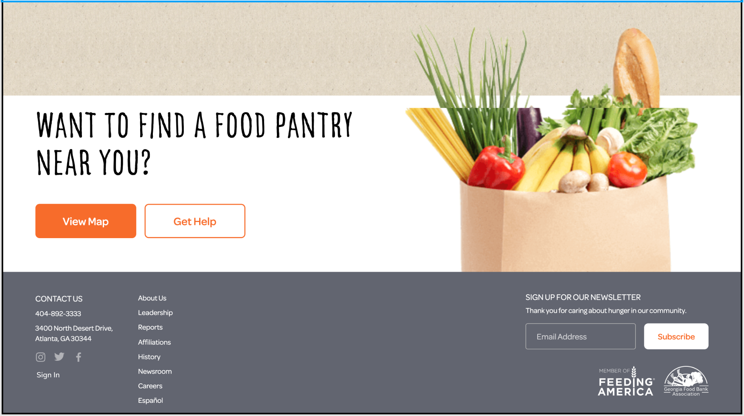
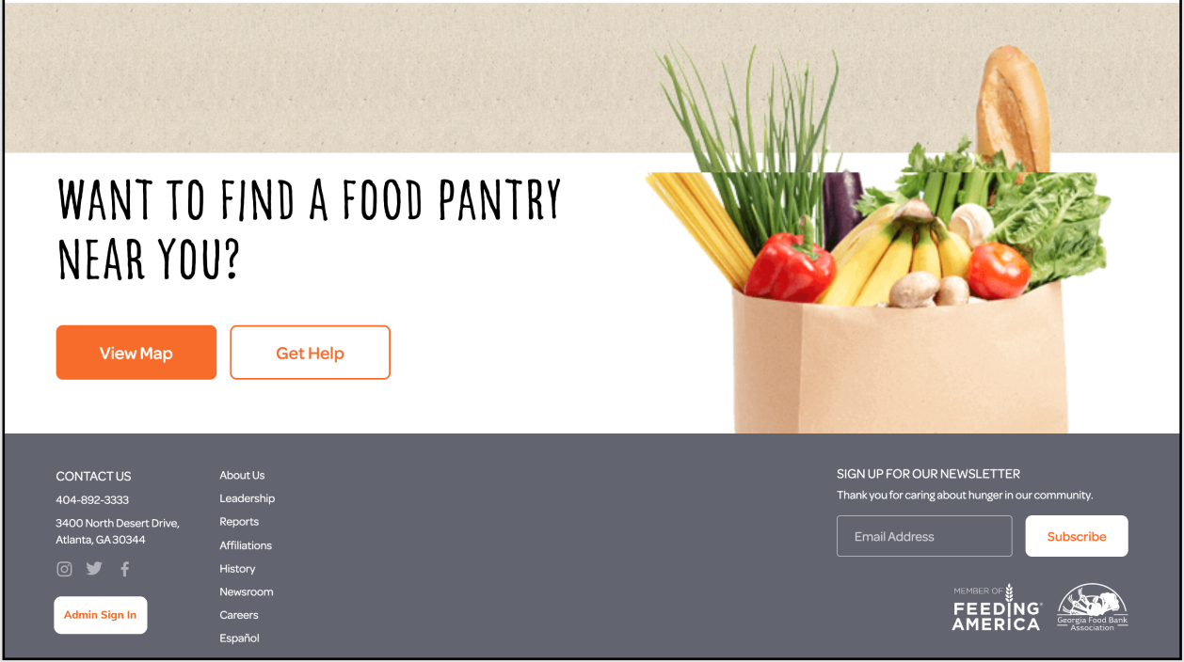
Changes to Prototype
Sign In Button
Future Change
Changing design and text of “Sign In” button
Other alterations we would make to our prototype include
Include “E-mail” text input field for delivery request form
Create an independent “Volunteer” button
Notes:
30 Seconds
Changes to Prototype: What changes did you make to the prototype during testing, if any? What changes would you make now, based on the testing? (optional), 1 PPt.
Based on our participation tests, we would change the sign in button to include the text “Admin” and have a rectangular box around it so that it is clear that the sign in is only for ACFB admins and make it easy for them to find the sign in button because our participants struggled locating it since the text was small and discreet. Other design alterations we would make to our prototype is to include an “email” text input field for the delivery request form so users can receive a delivery confirmation email. We would also include an independent “volunteer” button so that our volunteers are able to easily access the volunteer page.

Slide 9
Lesson Learned
No design is perfect.
UI Researchers need to put themselves in the perspective of the User when creating a design.
Testing the prototype is important
Notes:
30sec
Lessons Learned: What take-away lessons did you learn from the entire project, what would you do differently (and why)if you were to start over again - both in terms of the dynamics/structure of the group process itself, and in terms of the project?, 1 PPt.
Overall, the lessons we took away from the project is that no design is perfect and there can always be changes made to the prototype and as UI researchers, we need to put ourselves in the perspective of the User. Lastly, testing the prototype is important in order to see if the product is user friendly and make alterations. If we were to start over again, one thing we would do differently is get a different demographic of users who are closer to real ACFB users rather than proxy users to survey and test our prototype to get more accurate results and get better feedback on what could be improved.

